Slide 1
Introduction to Big Data Systems
Lecture 10. Stream Processing
Wenguang CHEN
Tsinghua University

Slide 2
References
Some contents are from
Nathan Marz《Storm:Distributed and Fault-Tolerant Real-time Computation》
Leonardo Neumeyer《S4:Distributed Stream Computing Platform》
Michael Stonebraker《The 8 Requirements of Real-Time Stream Processing》
Zhengping Qian 《Realtime Cloud Computing》《Use cases of Graph Analytics in Alibaba》
Jeff Holoman 《Kafka Introduction》
M. Zaharia, T. Das, H. Li, T. Hunter, S. Shenker, and I. Stoica. Discretized Streams: Fault-Tolerant Streaming Computation at Scale, SOSP 2013
Michael Stonebraker, Uğur Çetintemel, “One Size Fits All”: An Idea Whose Time Has Come and Gone, pp. 2-11, ICDE 2005

Slide 3
Purpose of the lecture
Demand for stream processing
Challenges of stream processing
A naïve implementation - Worker + Queue
Actor model
Case study – Storm
Case study – SparkStream
Fault tolerance of streaming systems

Slide 4
DEMAND FOR STREAM PROCESSING

Slide 5
Big data frameworks we have discussed
Batch processing, processing all data
Map-Reduce
Spark
GraphLab / Gemini
HDFS read
HDFS write
HDFS read
HDFS write
iter. 1
iter. 2
. . .
Input

Slide 6
Low Latency Demand : Fraud detection
Real-time Recommendation
Click-farming detection
Fast detection @ 100k transactions/s

Slide 7
Low Latency Demand : Fraud Detection
Real-time requirement: 50 ms latecny @ 100k transctions/s

Slide 8
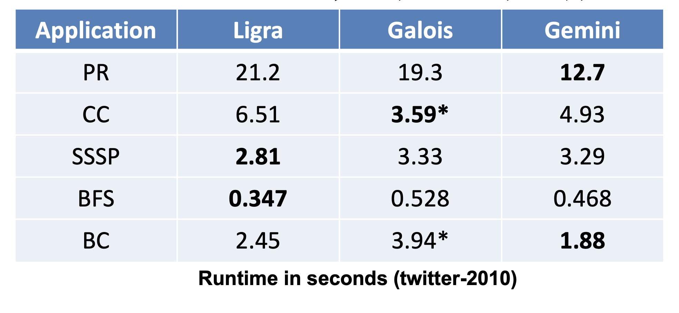
Existing systems
Does not support data update
Performance is far from requirement on a graph with medium size

Slide 9
Stream Processing
F(X +ΔX)= F(X) op H(ΔX)
When we calculate F(X +ΔX) , we don’t need to use X +ΔX，instead we only need F(X) and ΔX
We call this computing paradigm Stream Processing
Notes:
Top K，

Slide 10
View stream processing as state transitions
ΔX₁
ΔX₂
ΔX₃
S1
S2
S3
……
Is database a good stream processing system?

Slide 11
Another Example*
*Stonebraker M, Cetintemel U. " One size fits all": an idea whose time has come and gone[C]//Data Engineering, 2005. ICDE 2005
Notes:
Feeds: Reuters, Bloomberg and Infodyne
Providers: NYSE and NASD
receive an alert message each time there is a late tick from either provider
When 100 late ticks have been received from either provider, they wished to receive a special “this is really bad” message
accumulate late ticks from each of two exchanges, say NYSE, NASD
Specifically, there are 4500 securities, 500 of which are “fast moving”. A stock tick on one of these securities is late if it occurs more than five seconds after the previous tick from the same security. The other 4000 symbols are slow moving, and a tick is late if 60 seconds have elapsed since the previous tick. There are two feed providers and the company wished to receive an alert message each time there is a late tick from either provider. In addition, they wished to maintain a counter for each provider. When 100 late ticks have been received from either provider, they wished to receive a special “this is really bad” message and then to suppress the subsequent individual tick reports The last wrinkle in the company’s specification was that they wished to accumulate late ticks from each of two exchanges, say NYSE and NASD, regardless of which feed vendor produced the late data. If 100 late messages were received from either exchange through either feed vendor, they wished to receive two additional special messages. In summary, they want four counters, each counting to 100, with a resulting special message. An abstract representation of the query diagram for this task is shown in Figure 3

Slide 12
Use traditional database
900 message/s

Slide 13
Stream Processing
160,000 message/s

Slide 14
Challenges of stream processing

Slide 15
Goal of Stream Processing
Real-time / scalability
Fault tolerance
Faults in data
Faults in systems
Programmability

Slide 16
Real-time / Scalability
Batch processing
Fixed problem size
Latency: Tens of hours processing time
Stream Processing
Arrival rate varies heavily
Latency: Seconds or even less
Processing all coming data or
Pre-defined degrading approach

Slide 17
Fault Tolerance
Batch
ETL can remove faults in data
Checkpoint and/or recalculation
Streaming
Has to deal with data fault in real time
Fault tolerance mechanism must be low-overhead, and maintain the real time demand
Notes:
Extract, Transform and Load

Slide 18
Programmability
Natural
Coverage
Do not need to take care of fault tolerance and load balance

Slide 19
Stream Processing
Programming
Model
Fault
Tolerance
Real time/
Scalability

Slide 20
Naïve implementation

Slide 21
Mismatched Speed of Producer/Consumer
Data Source
Stream Processing System
Processing throughput
Input arrival rate

Slide 22

Mismatched Speed of Producer/Consumer : Add a Queue
Data Source
Stream Processing System
Processing Speed
Input Data speed
Queue is used to address the TEMPORAL speed mismatch

Slide 23

Worker + Queue
Worker：Processing Unit
Filter
Join
…
Queue ：Buffer
Queue is also used for other purposes
Notes:
Show Queue here, multiple producers, multiple consumers
Queue buffers the content for temporary unmatched producer/consumer speed
Also there are topics in the queue which route the specific message to consumers
Messages are also persisted to allow 容错

Slide 24
Queue: Interfaces
producer
consumer
producer
consumer
producer
producer
consumer

Slide 25
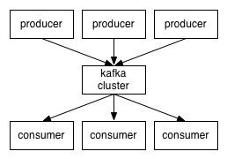
Queue
Matching Producers and Consumers
Speed
Interfaces
Publish – Subscribe model
Persistency
Performance optimization
Notes:
Show Queue here, multiple producers, multiple consumers
Queue buffers the content for temporary unmatched producer/consumer speed
Also there are topics in the queue which route the specific message to consumers
Messages are also persisted to allow 容错

Slide 26
An Example: Web analytics
Twitter
6000 tweets per second，500m / day
Statistics on tweets and related clicks
How many tweets contains a certain URL today?
How many clicks on these URLs?
It is a stream version of word count

Slide 27
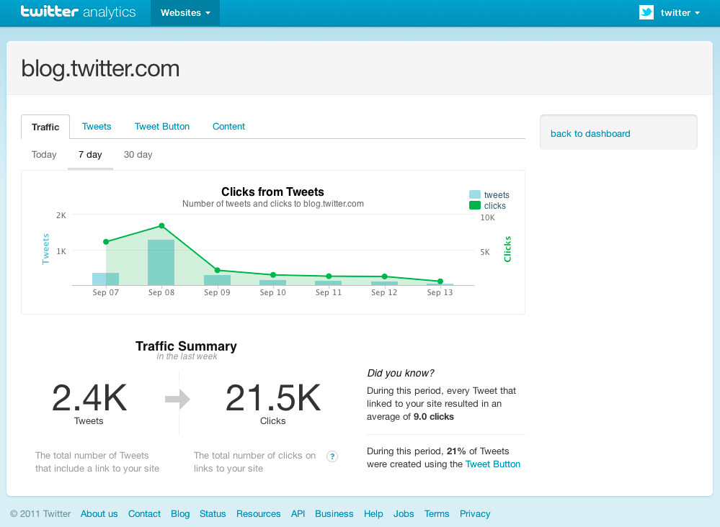

Slide 28
<url1,1>
Update url1
Update url2
Twitter
Source
<url2,1>
DB
<url1, 21>
<url2, 100>
<url3,3>
…
<tweet1>
*** url1 ***
<tweet2>
*** url2 ***
<tweet3>
*** url3 ***
…
Update url3
<url3,1>
Notes:
Input tweet1, tweet2, tweet3
After first level worker, url1, url2, url3
Final worker write the data into database
Same URL go to the same worker ,to avoid transactions and enable batching
Use hash to find queue for workers

Slide 29
Problems
Poor scalability
Hard to tolerate faults
Complicated code
Programming
Model
Fault
Tolerance
Real time/
Scalability
Notes:
如果要增加一个worker？

Slide 30
Actor model

Slide 31
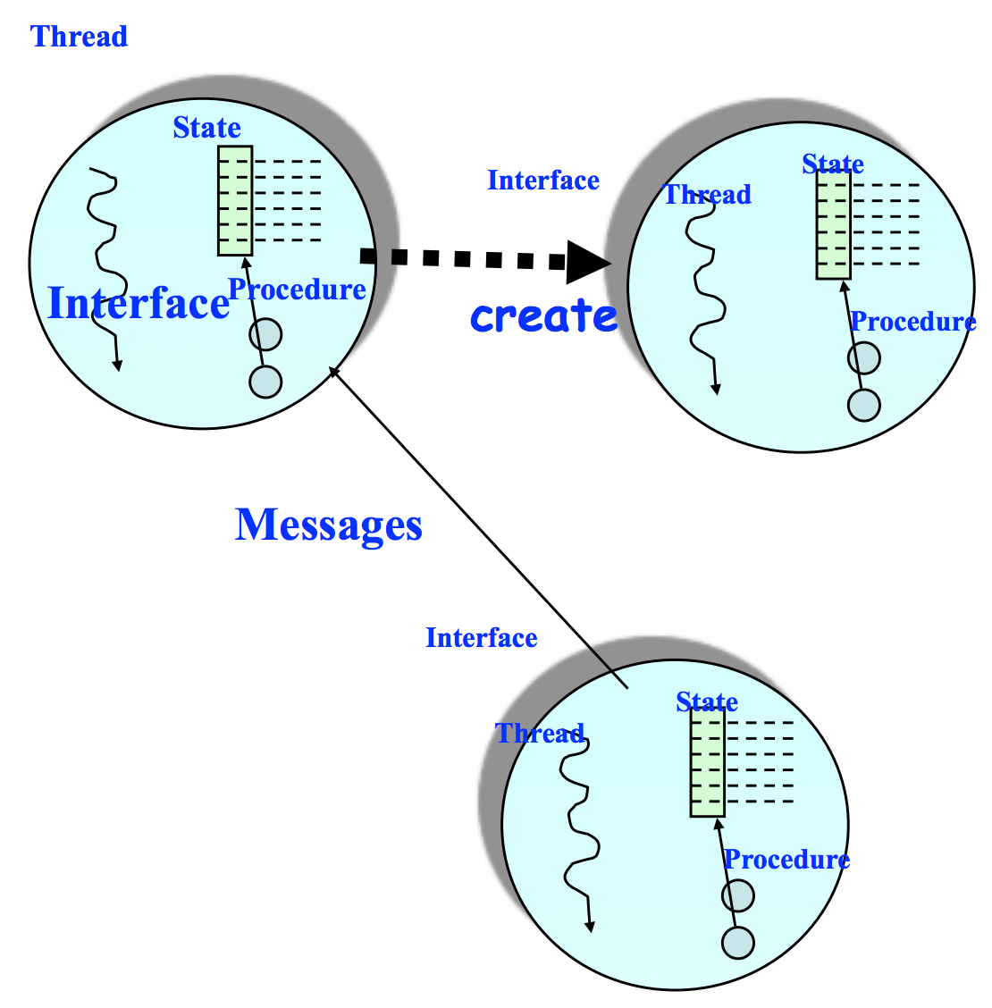
Actor Model
An actor
An asynchronous concurrent programming paradigm
An actor may
Process messages
Change local state
Create new actors
Send messages

Slide 32
Actor Model
First defined in 1973 by Carl Hewitt
Key ideas
Everything is an Actor
Analogous to “everything is an object” in OOP
Encapsulate shared state in Actors
Mutable state is not shared
Other important features
Transparent addressing
Asynchronous message passing
Non-deterministic ordering of messages
No assumption on channel
Unbounded delay
Best effort message delivery
Only one message is processed at a time conceptually

Slide 33
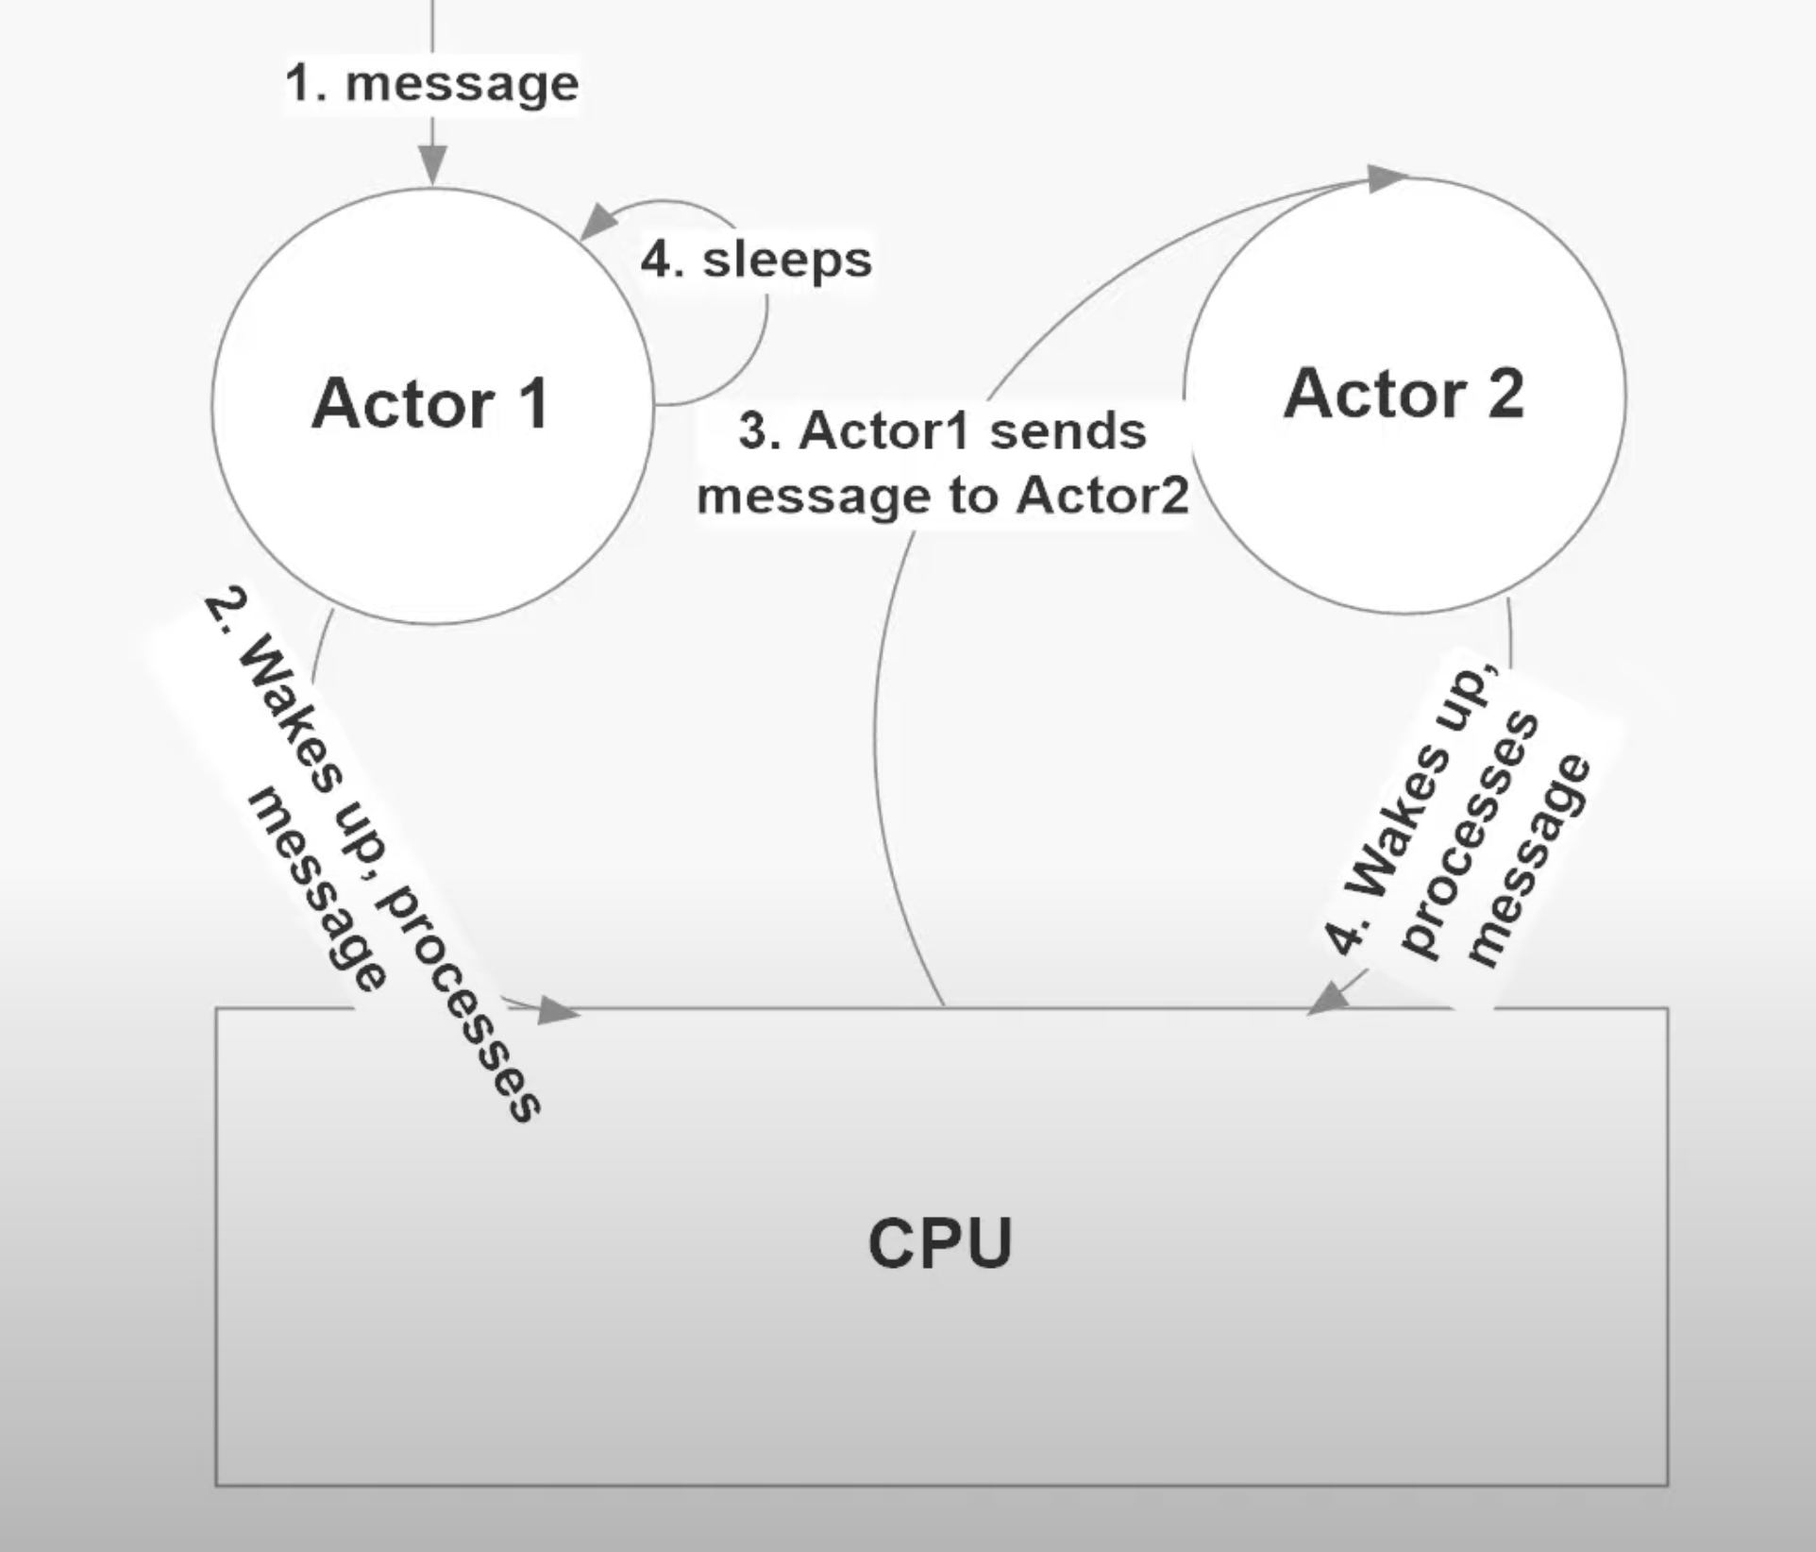
Actor run asynchronously*
When and How to Use the Actor Model An Introduction to Akka NET Actors
https://www.youtube.com/watch?v=0KnIMDoJpZs

Slide 34
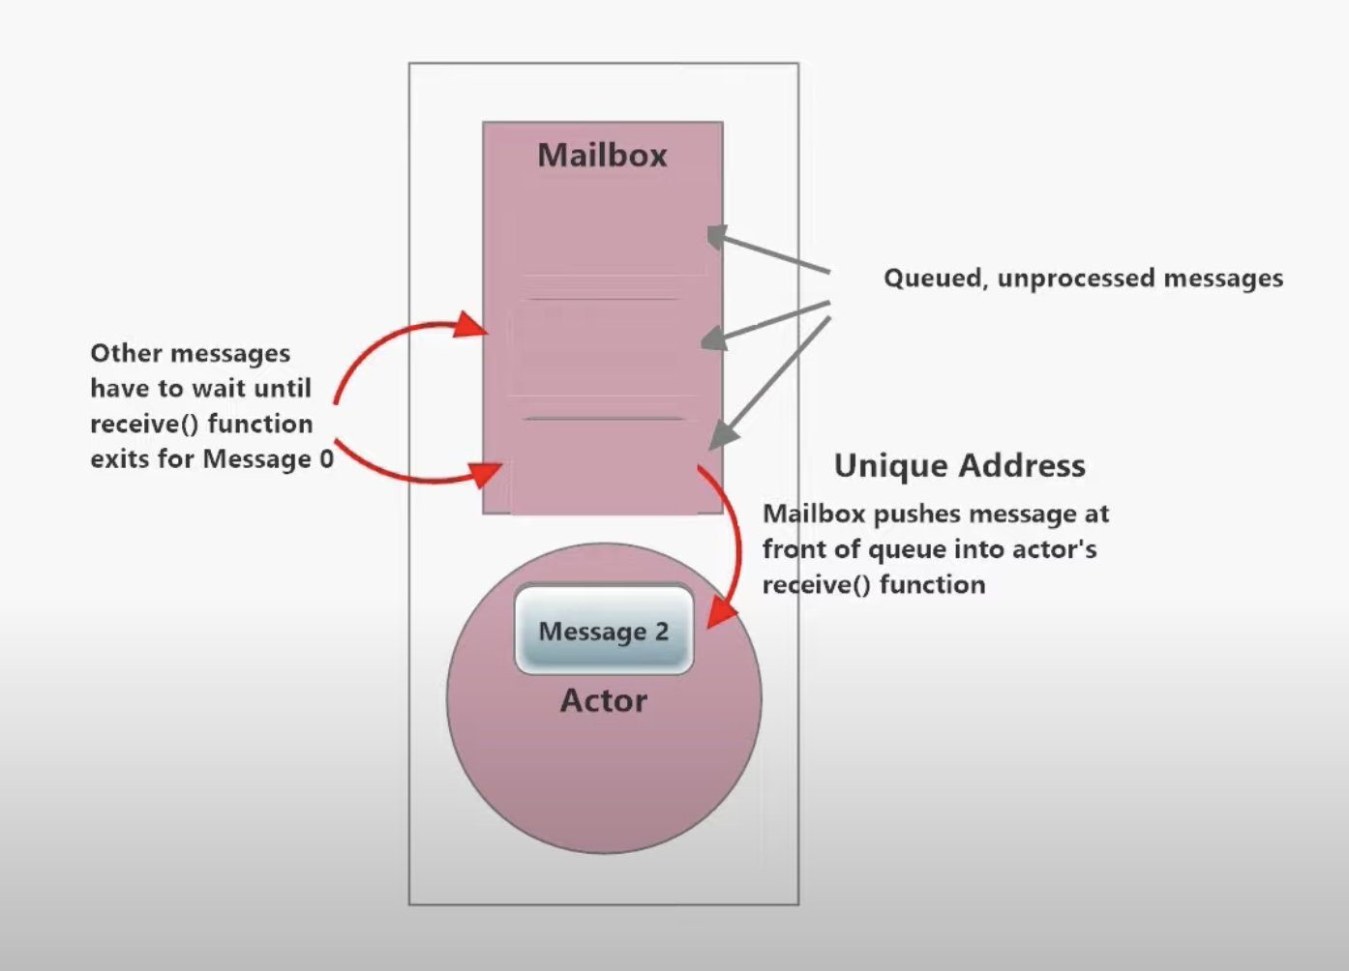
Actors process Message one at a time

Slide 35
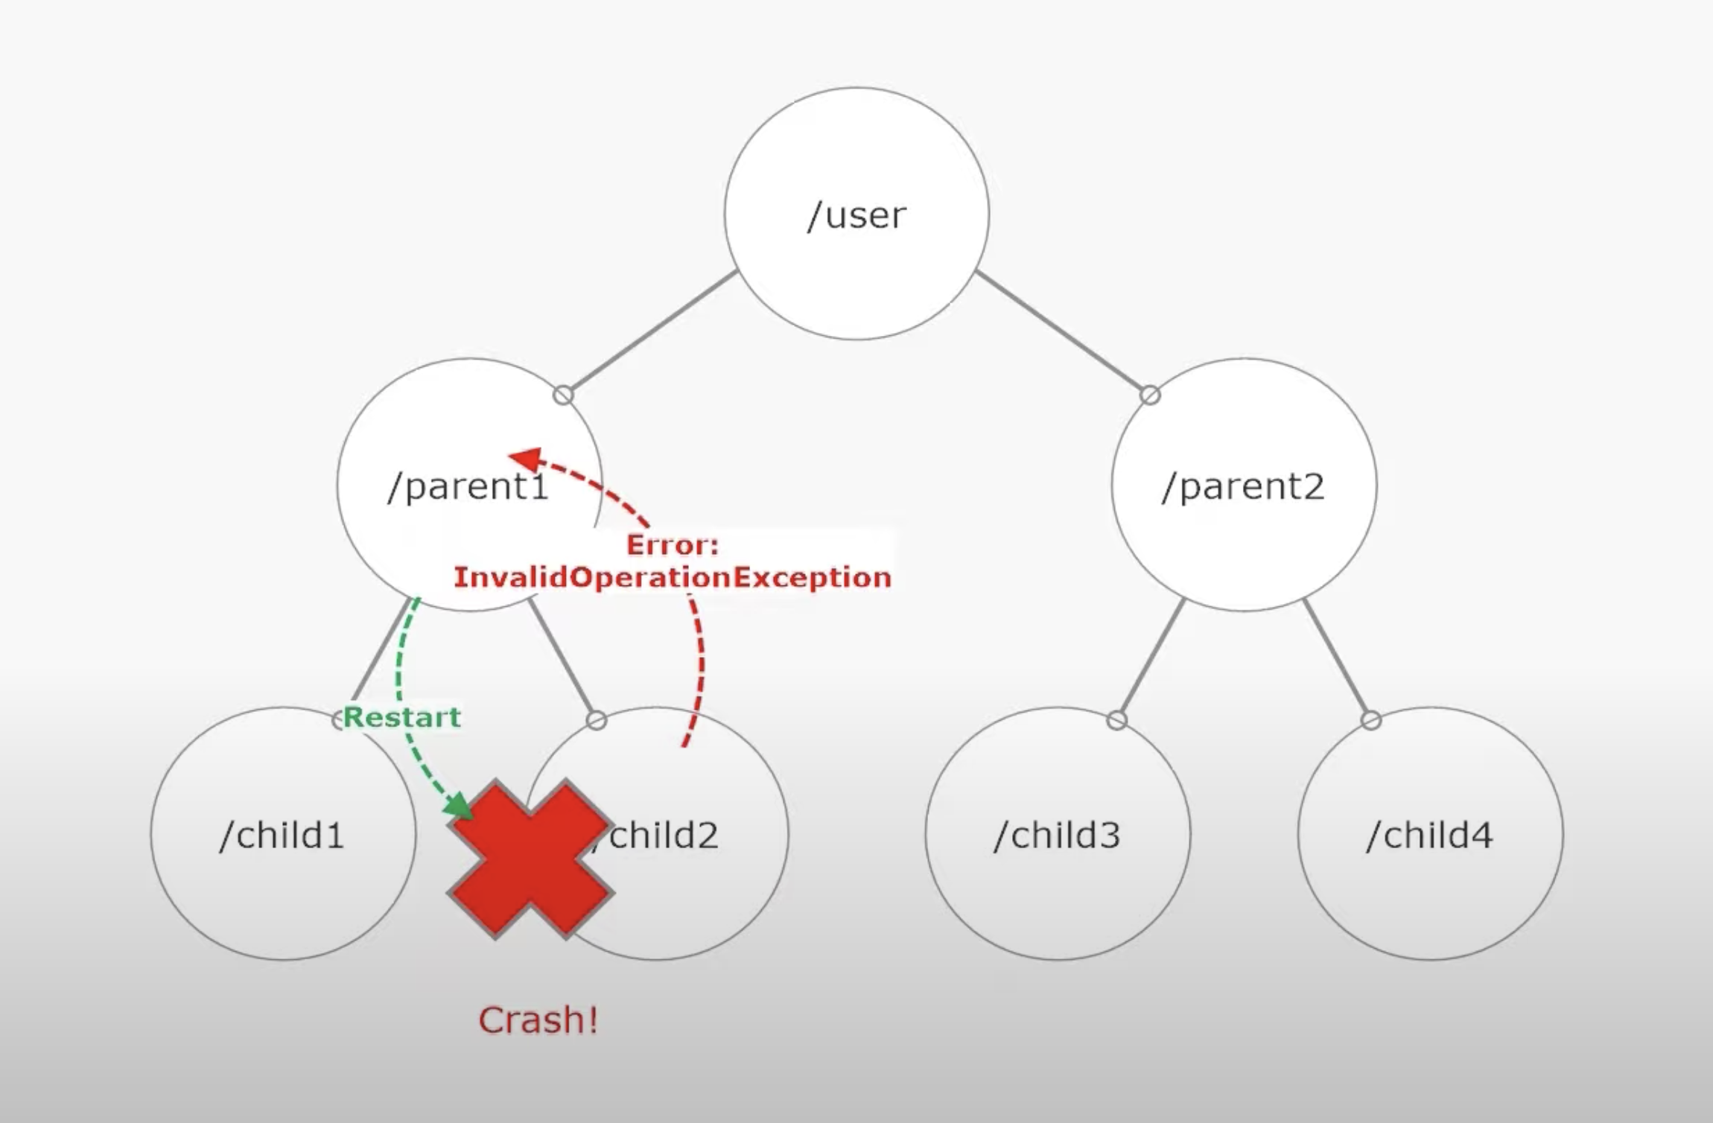
Actors in hierarchy

Slide 36
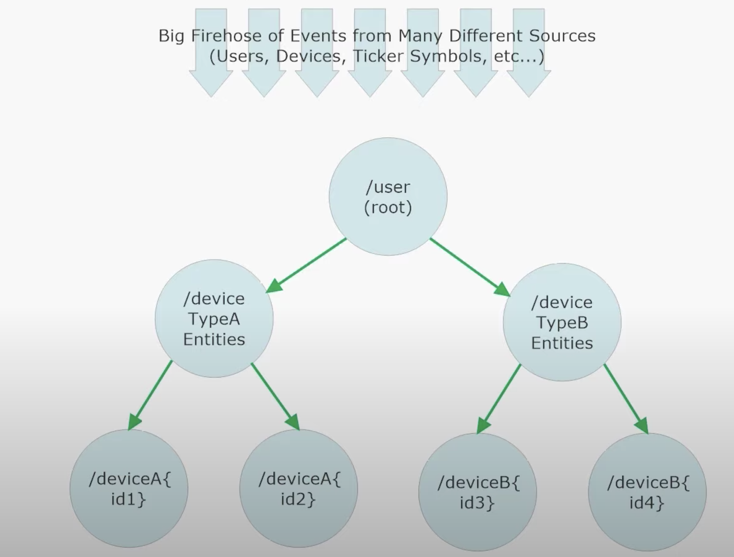
Actors reduce big problems into smaller ones

Slide 37
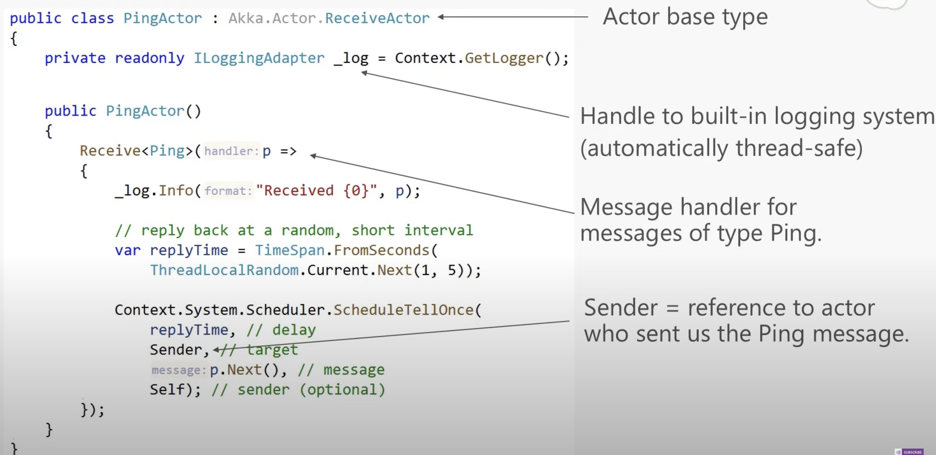
Sample Actor code( Akka.NET)

Slide 38
Popular Actor Systems
Good start for distributed system building, especially for streaming systems
Akka(Java, .NET)
Orleans(.NET)
Erlang/Elixir
Pulsar(Python)
CAF(C++)
Axiom(Rust)
Ray(Python,Java, C++)

Slide 39
Comparison Actor models with Queue Systems
 | Actor Model (akka) | Queue (Kafka) | MPI
Messaging modes | Asynchronous | Asynchronous (Pub/Sub) | Synchronous / Asynchronous
Latency | ~1 us | ~100ms | ~1 us
Persistency | N | Y | N
Purpose | Building concurrent systems | Connecting different systems | Building parallel computing applications

Slide 40
An enterprise data pipeline
Apps
Database
(MySQL)
Queue
(Kafka)
RealTime ETL
（Flink,SPARK)
OLTP
（Hbase, KV,ES)
ETL
（Flink,Spark
+HUDI)
DataLake
（MPPDB，HDFS)
Analysts
OLAP
（Presto,CK)

Slide 41
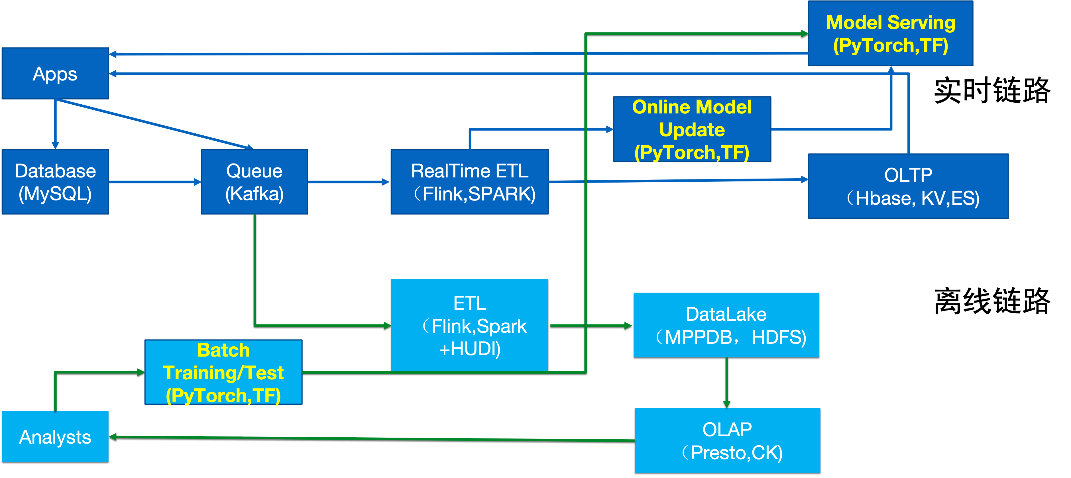
Data + ai pipeline

Slide 42
Stream processing- Storm

Slide 43
Storm
Data Type: Tuple
Named list of values
[:name “Chen” :age 40], similar to <key, value>

Slide 44
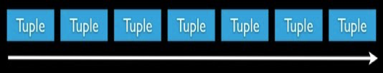

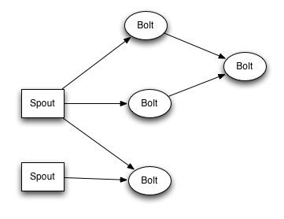

Storm Concepts
Stream
Spout
Bolt
Topology

Slide 45
Stream
Data Type
Storm supports all primitive type，String and byte array as types of tuple value
User could define types but need to implement the serialization method

Slide 46
Bolts
Filters
Aggregation
Joins
Access databases
Run user defined functions

Slide 47
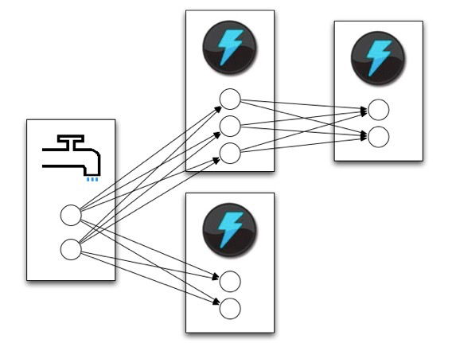
Tasks and parallelism

Slide 48
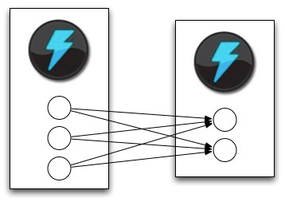
Stream Grouping

Slide 49
Stream Grouping
Shuffle Grouping：Randomly
Fields Grouping：Choose according to tuple field’s value
All Grouping：all tasks
Global Grouping：send to tasks with the minimum id

Slide 50
ExclamationTopology
TopologyBuilder builder = new TopologyBuilder();
builder.setSpout("words", new TestWordSpout(), 10);
builder.setBolt("exclaim1", new ExclamationBolt(), 3) .shuffleGrouping("words");
builder.setBolt("exclaim2", new ExclamationBolt(), 2) .shuffleGrouping("exclaim1");

Slide 51
TestWordSpout
public void nextTuple()
{ Utils.sleep(100);
final String[] words = new String[] {"nathan", "mike", "jackson", "golda", "bertels"};
final Random rand = new Random();
final String word = words[rand.nextInt(words.length)];
_collector.emit(new Values(word));
}

Slide 52
ExclamationBolt
public void execute(Tuple tuple) {
_collector.emit(tuple, new Values(tuple.getString(0) + "!!!"));
_collector.ack(tuple);
}
public void declareOutputFields(OutputFieldsDeclarer declarer) {
declarer.declare(new Fields("word"));
}
Notes:
Emit
Ack
Fields

Slide 53
WordCount

Slide 54
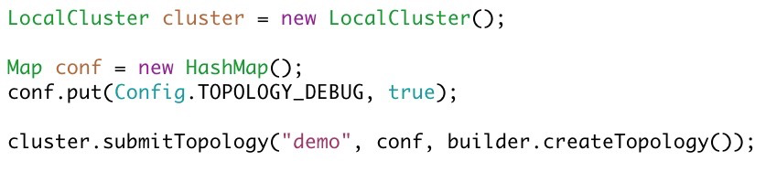
Running Storm

Slide 55
Stream processing- fault tolerance

Slide 56
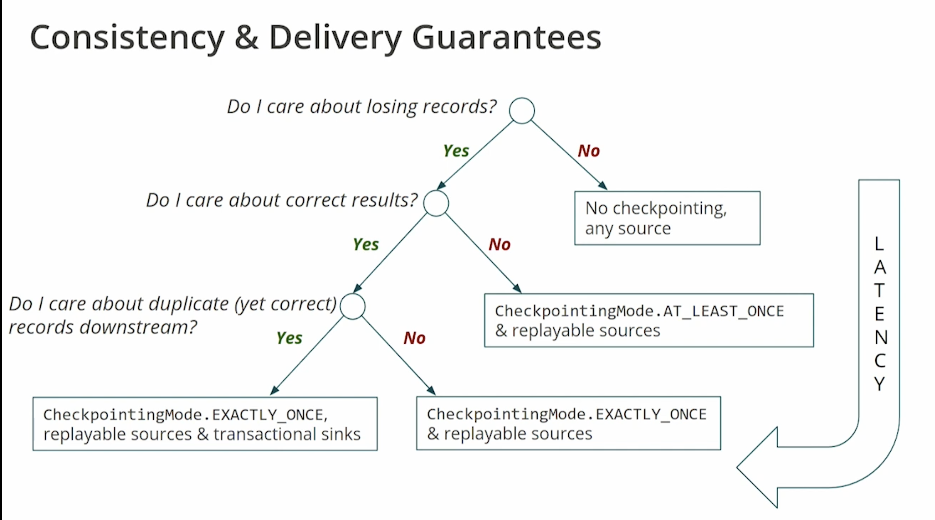
Different fault tolerance levels
At most once, At least once, Exactly once
AT_MOST_ONCE

Slide 57
Fault tolerance in Stream Processing
Per element processing(at least once) - Storm
Mini-batch(Exactly once) – SparkStream
Per element processing(Exactly once) - Flink

Slide 58
Fault tolerance in Storm

Slide 59
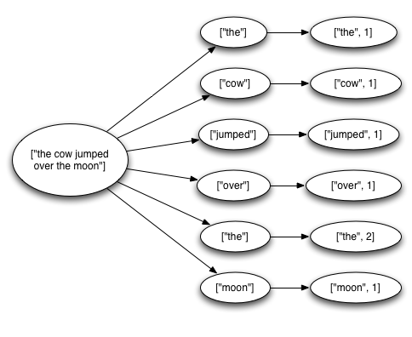
Fault tolerance in Storm
All three levels are supported, but EXACTLY_ONCE is supported with a higher level interface( Storm_Trident)
Let’s see how to support AT_LEAST_ONCE
Notes:
系统需要知道所有这些“the” 来自 哪里，也需要知道“the”什么时候已经处理完
Spout和queue系统有交互，可以要求重发
消息在timeout时间内，要么完整处理，要么fail
但重发消息如何能够保证应用容错，是程序员的事情
At least once processing, 如何处理计数问题？

Slide 60
Complete processing of a message
When spouts emit tuples, specify a unique message ID.
When bolts are done processing the input tuple, ack or fail the input tuple.

Slide 61
ExclamationBolt
public void execute(Tuple tuple) {
_collector.emit(tuple, new Values(tuple.getString(0) + "!!!"));
_collector.ack(tuple);
}
public void declareOutputFields(OutputFieldsDeclarer declarer) {
declarer.declare(new Fields("word"));
}
But this ack only means a bolt has processed the message
How does Storm know that this message has been COMPLETELY processed?
Notes:
Emit
Ack
Fields

Slide 62
How to track if the message has been processed?
One solution is to use bitmap like approaches, if you have the global view on how a message should be processed
It is challenging because the paths may be dynamic…

Slide 63
How to track if the message has been processed?
We can follow the message flow to see if there are outstanding messages
Use a data structure to record the generations/acknowledgement of messages
Do we need a new entry for each of generated message?
Generate message 1
Generate message 2
Process and acknowledge message 1

Slide 64
Maintain the pending message
Message 1 , acknowledged
Message 2, pending
…
High memory overhead, also does not know who is the root message of them
Generate message 1
Generate message 2
Process and acknowledge message 1

Slide 65
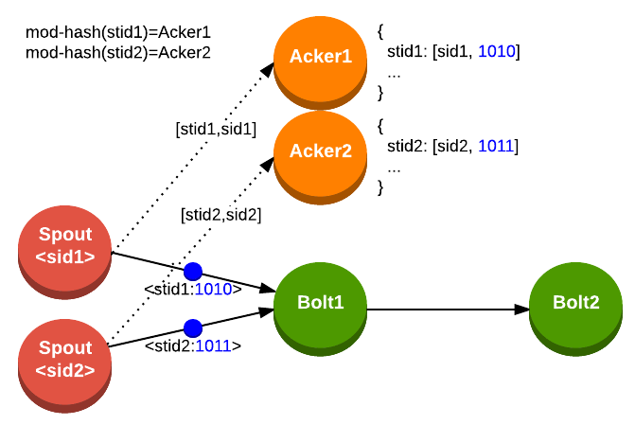
Samples from https://bryantsai.com/fault-tolerant-message-processing-in-storm/
Notes:
When a spout emits a tuple, it notifies a specific acker task about the new tuple’s ID and its own task ID
Sid1: task id
Stid1: tuple id (64 bit in practice, here 4 bits for simplicity)
Stid stands for the entry of the system. When generate a message, XOR it in the entry

Slide 66
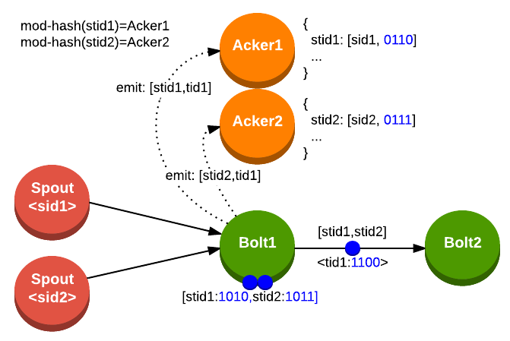
Notes:
Bolt1 receives tuples “stid1” and “stid2” and then emits tuple “tid1” anchored to both (multi-anchoring)

Slide 67


Slide 68
Cost of AT_LEAST_ONCE: 2X messages, and hurt performance

Slide 69
Exactly once?
Requires a way to control state update to avoid partial change to the state

Slide 70
Fault tolerance in Sparkstream

Slide 71
Why fault tolerance is it hard?
Stateful continuous operators tightly integrate “computation” with “mutable state”
Makes it harder to define clear boundaries when
computation and state can be moved around
mutable state
stateful
continuous operator
input
records
output
records
Notes:
So we accepted the challenge and decided to understand why it is hard.
That is because the continuous operator model tightly integrates computation with mutable state.
This makes it harder to define clear boundaries in the computation and state such that they can be move around.

Slide 72
Review: How Spark deal with Fault Tolerance
Computation are implemented as deterministic transformations on immutable data sets
messages = textFile(...).filter(_.contains(“error”))
.map(_.split(‘\t’)(2))
HadoopRDD
path = hdfs://…
FilteredRDD
func = _.contains(...)
MappedRDD
func = _.split(…)

Slide 73

Batch Processing Systems
Batch processing systems like MapReduce/Spark divide
Data into small partitions
Jobs into small, deterministic, stateless map / reduce tasks
M
M
M
R
R
M
M
M
R
R
M
M
M
R
R
M
immutable input dataset
M
immutable output dataset
M
immutable
map outputs
stateless map tasks
stateless reduce tasks
Notes:
Systems like MapReduce to divide the data into smaller partitions, and the job into small deterministic and stateless map reduce tasks. Lets walk through a map reduce job. You start from an immutable dataset already divided into partitions. For each partition, the system runs a bunch of stateless map tasks which generate immutable map outputs. Then they are shuffled together and stateless reduce tasks generate the output immutable dataset

Slide 74
Parallel Recovery
Failed tasks are re-executed on the
other nodes in parallel
M
M
M
R
R
R
M
M
M
M
R
R
R
M
M
M
M
R
R
M
immutable input dataset
M
immutable output dataset
M
M
stateless map tasks
stateless reduce tasks
Notes:
And because these tasks are stateless they can be moved around easily. For example, if a node fails, and some maps tasks are lost and some reduce tasks are lost as well, and some partitions in the output were not generated. The system can automatically re run the map tasks in parallel on the other nodes. And then also the reduce tasks, finally generating the ncessary partitions.
Lets see how we use this parallel recovery property in our streaming processing model that we call Discretized Stream Processing.

Slide 75
Discretized Stream Processing
Run a streaming computation as a series of small, deterministic batch jobs
Store intermediate state data in cluster memory
Try to make batch sizes as small as possible
to get second-scale latencies

Slide 76
Dissociate computation from state
Make state immutable and break computation into small, deterministic, stateless tasks
Defines clear boundaries where state and computation
can be moved around independently
state 1
state 2
state 2
stateless task
stateless task
stateless task
input 1
input 2
input 3
Notes:
Instead what we propose is to dissociate the computation from state. that is, make the state immutable, and break the computation into smaller deterministic and stateless tasks.
So to do stateful operation, the system would take the previous state as input to the stateless task and generate the next state as output. And this continues with more tasks.
This defines clear boundaries where state and computation can be moved around independently.
Now this sound very abstract but the interesting this is that existing systems already do this.

Slide 77
Discretized Stream Processing
time = 0 - 1:
batch operations
input
Input: replicated dataset stored in memory
Output or State: non-replicated dataset
stored in memory
time = 1 - 2:
input
…
…
input stream
output / state stream

Slide 78
Example: Counting page views
Discretized Stream (DStream) is a sequence of immutable, partitioned datasets
Can be created from live data streams or by applying bulk, parallel transformations on other DStreams
creating a DStream
views
ones
counts
views = readStream("http:...", "1 sec")
ones = views.map(ev => (ev.url, 1))
counts = ones.runningReduce((x,y) => x+y)
t: 0 - 1
map
reduce
t: 1 - 2
transformation
Notes:
Lets see how to program against this model. The programming abstraction that we provide is called Dstream, short for Discretized streams, which is a sequence of immutable partitioned datasets. These Dstreams can either be created from the live data stream, as shown in the program. readStream creates a dstream from live data stream of page views. Or Dstream can be created by applying bulk parallel transformations on other Dstreams, as shown in the program by the map and running reduce. This program maintains a running count of the page views. The underlying datasets look like this. as you can see the counts, the blue datasets are the state datasets that addup the counts across batches.

Slide 79
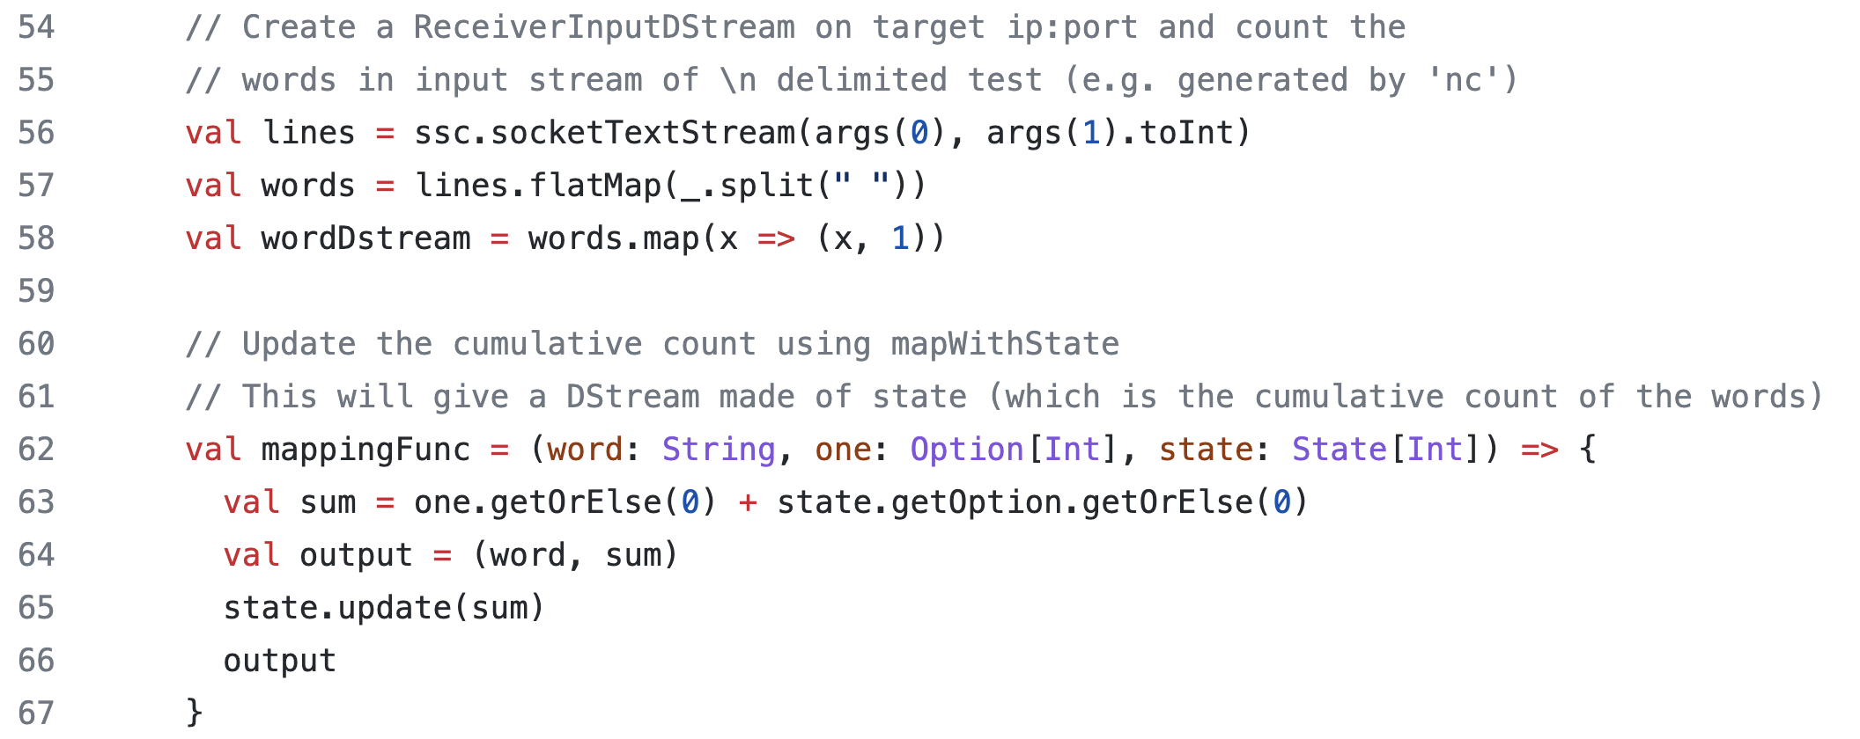
SparkStream WordCount code example*
https://github.com/apache/spark/blob/master/examples/src/main/scala/org/apache/spark/examples/streaming/StatefulNetworkWordCount.scala#L69

Slide 80
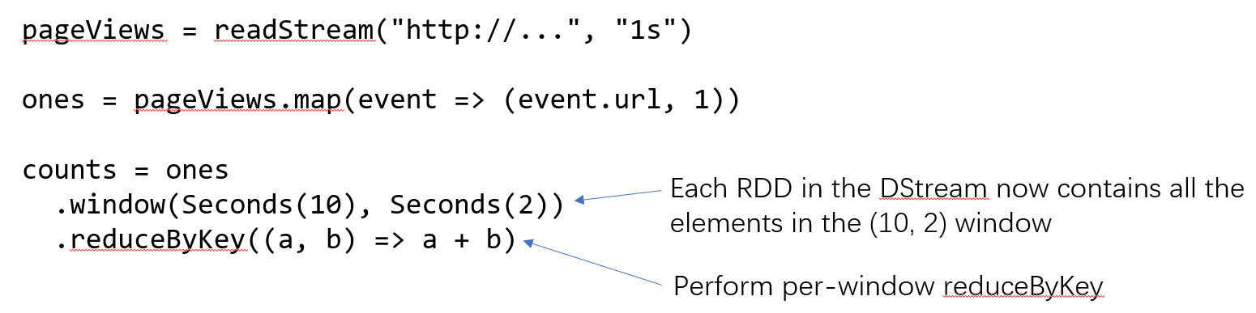
SparkStream Timewindow WordCount
Notes:
(10,2) means 10 seconds time windows, with 2s sliding

Slide 81
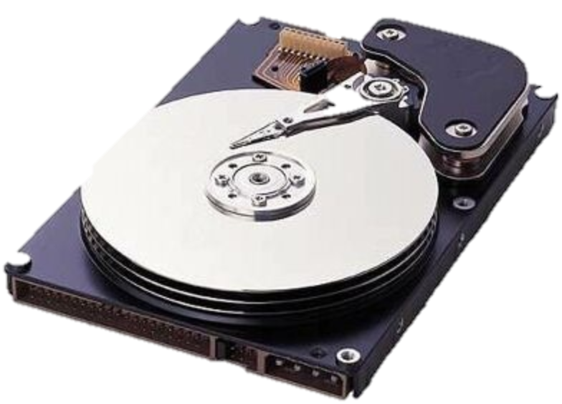
Fine-grained Lineage
Datasets track fine-grained operation lineage
Datasets are periodically checkpointed asynchronously to prevent long lineages
views
ones
counts
t: 0 - 1
map
reduce
t: 1 - 2
t: 2 - 3
Notes:
The system keeps track of the fine-grained partition level lineage. Now we don’t want the lineage to grow too long as that would cause a lot of recopmutation. so we periodically checkpoint some state rdds to stable storage and cut off the lineage. Note that these datasets are immutable, so checkpointing can be done asynchronously without blocking the computation.

Slide 82
Flink - Per-event processing with exactly-once

Slide 83
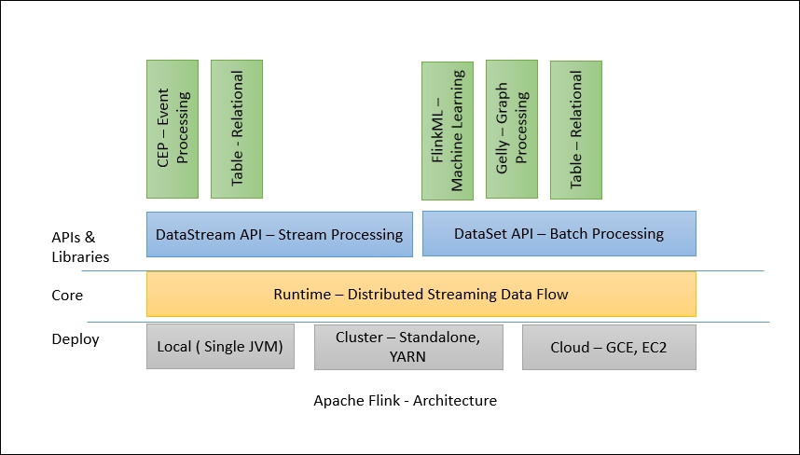
Flink Architecture
https://subscription.packtpub.com/book/big_data_and_business_intelligence/9781786466228/1/ch01lvl1sec8/architecture

Slide 84
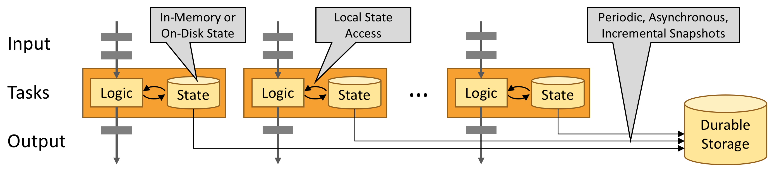
Local State in Flink
KVs such as RocksDB are typically used for local state

Slide 85
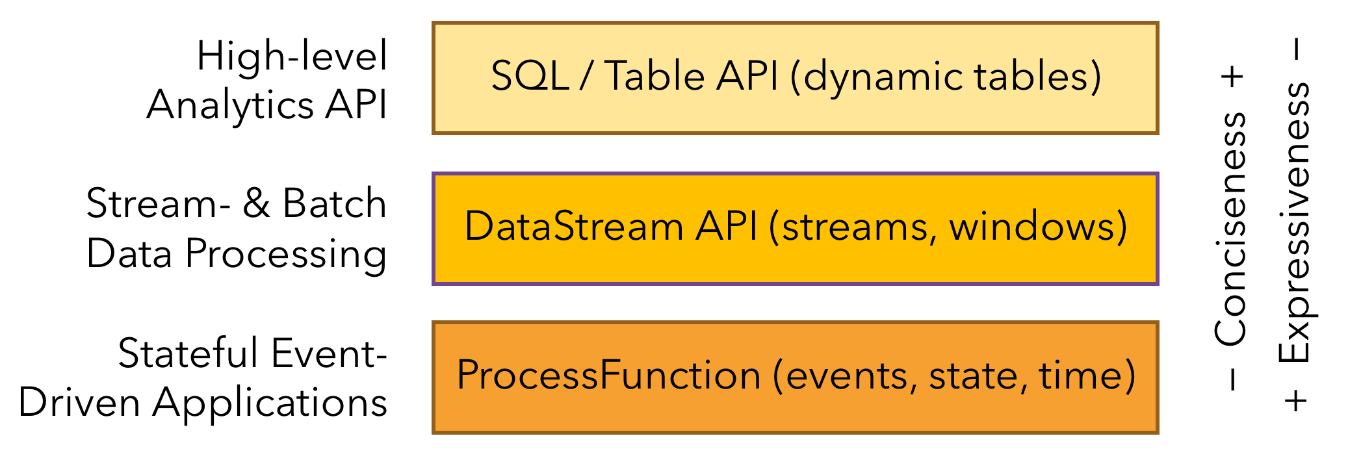
Flink interfaces

Slide 86
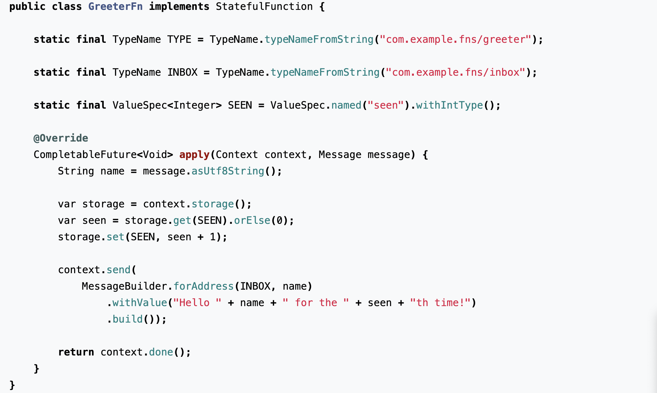
Stateful function examples

Slide 87
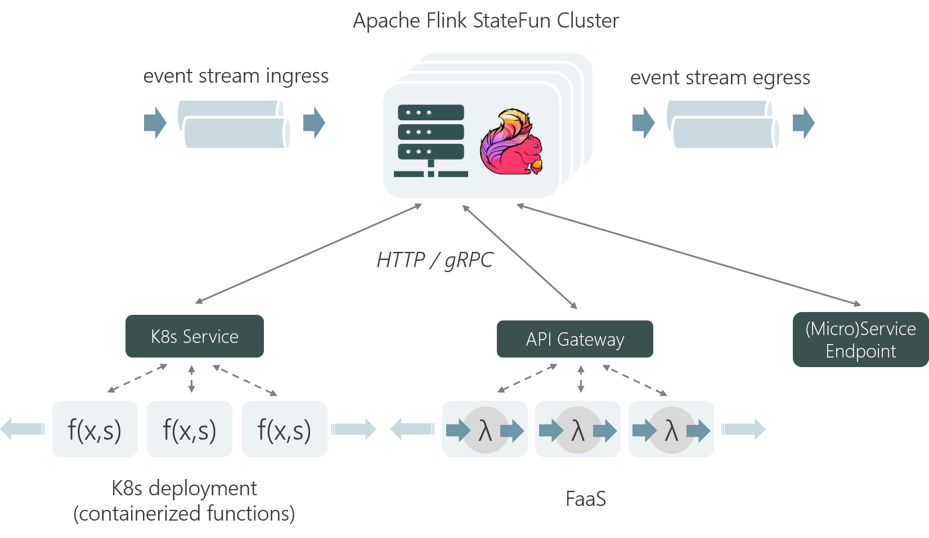
A Runtime built for Serverless Architectures

Slide 88
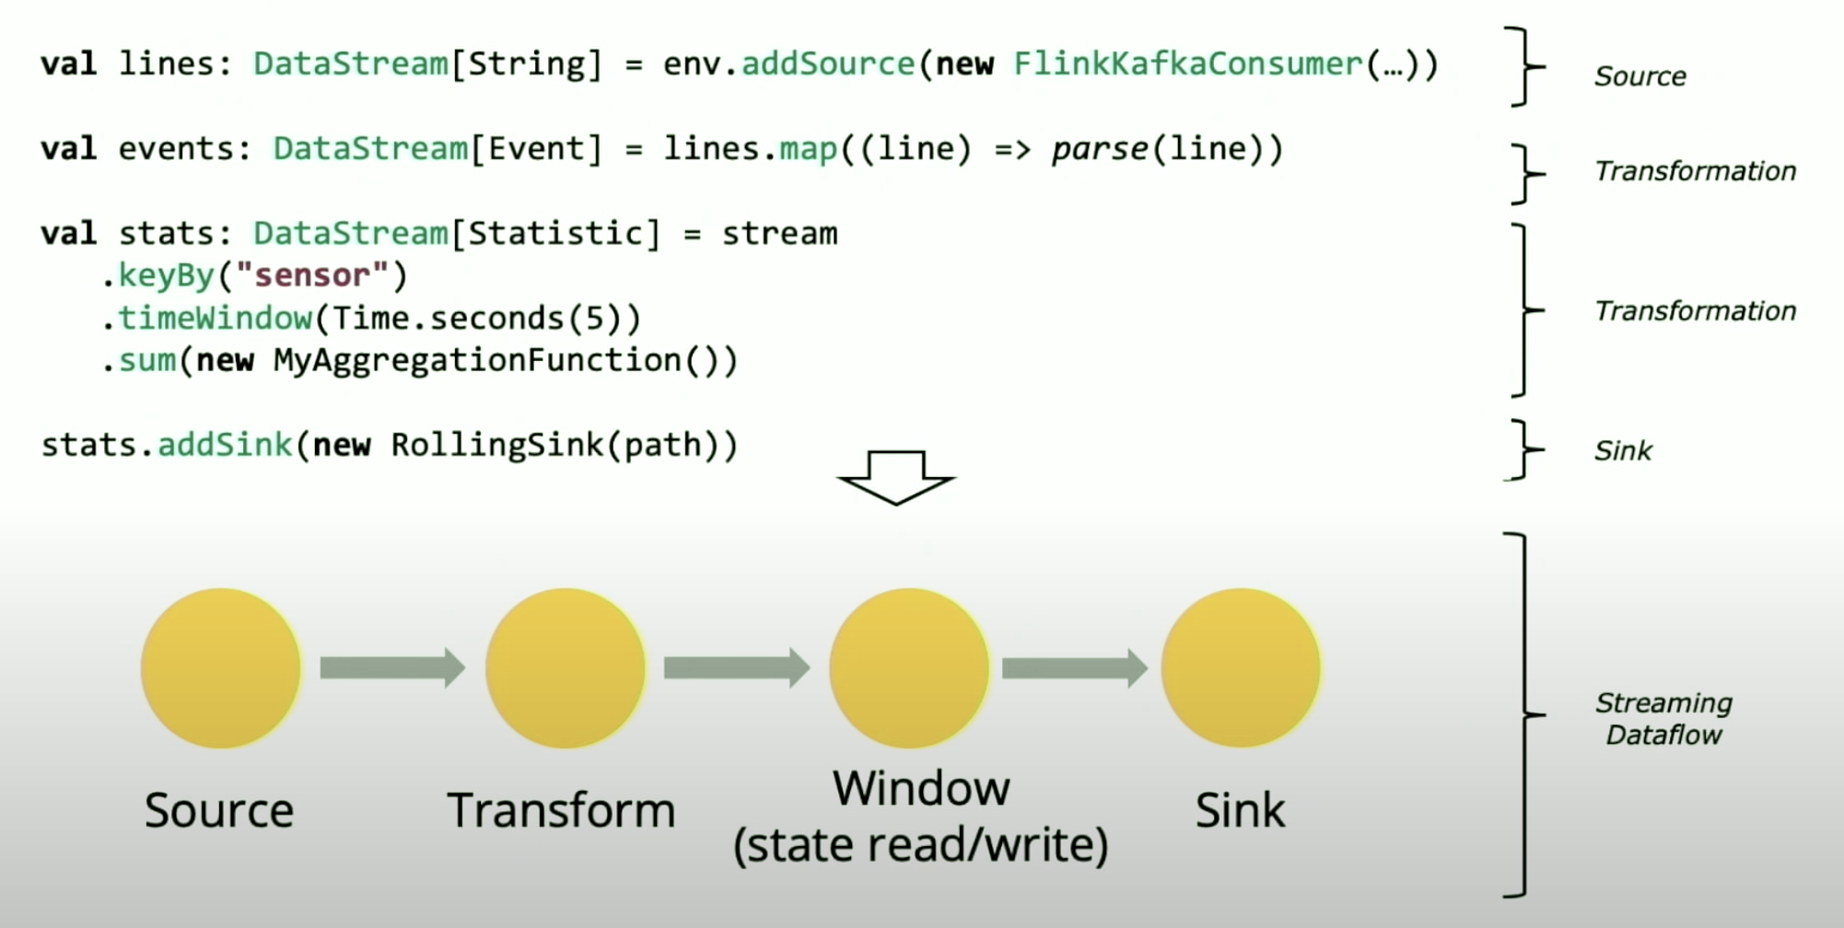
A Flink DataStream Example
Notes:
KeyBy – change datastream into KeyedStream
addSink - add receivers

Slide 89
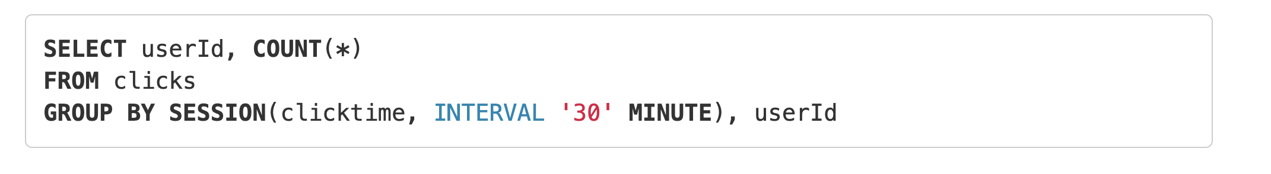
Flink SQL interfaces

Slide 90
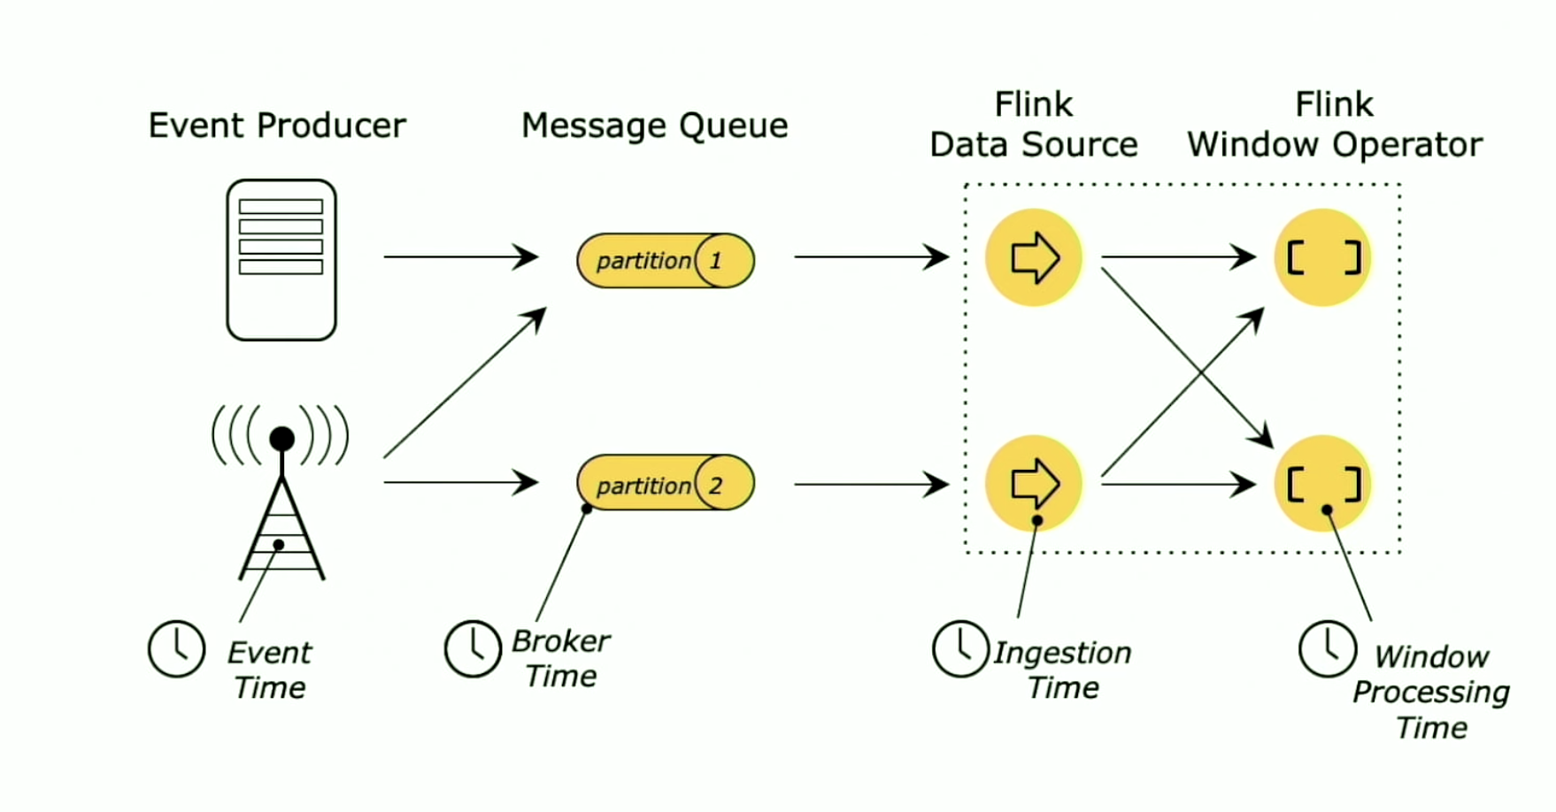
Different time in stream computing

Slide 91
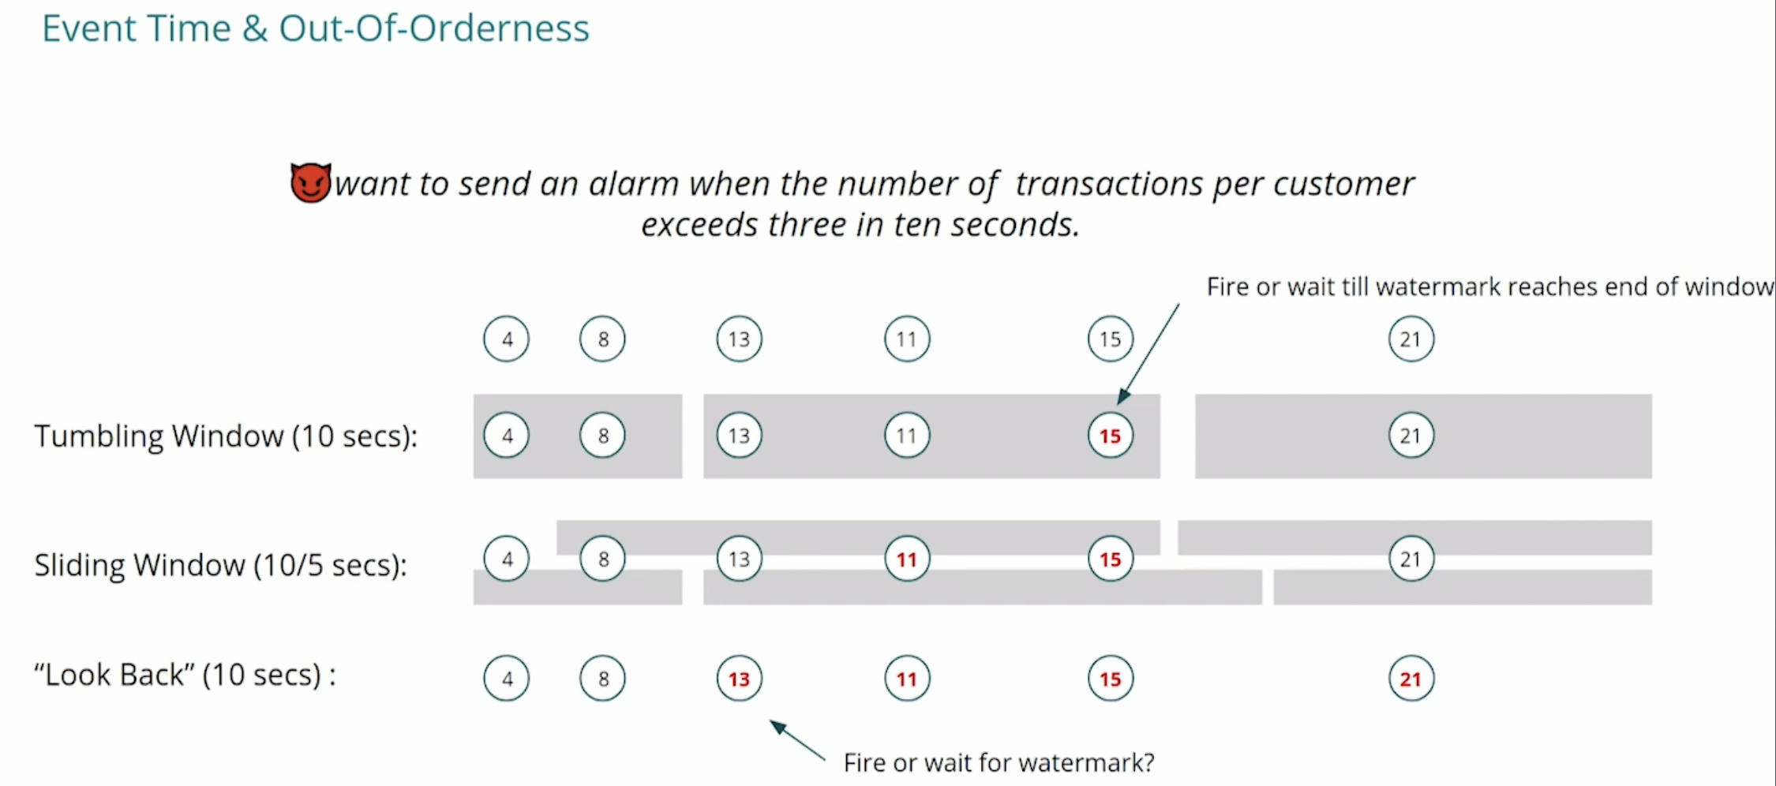
Different time windows

Slide 92
Fault tolerance for per-element processing
Checkpoint based fault tolerance
Checkpoint consistency?
Requirement to input and sink?

Slide 93
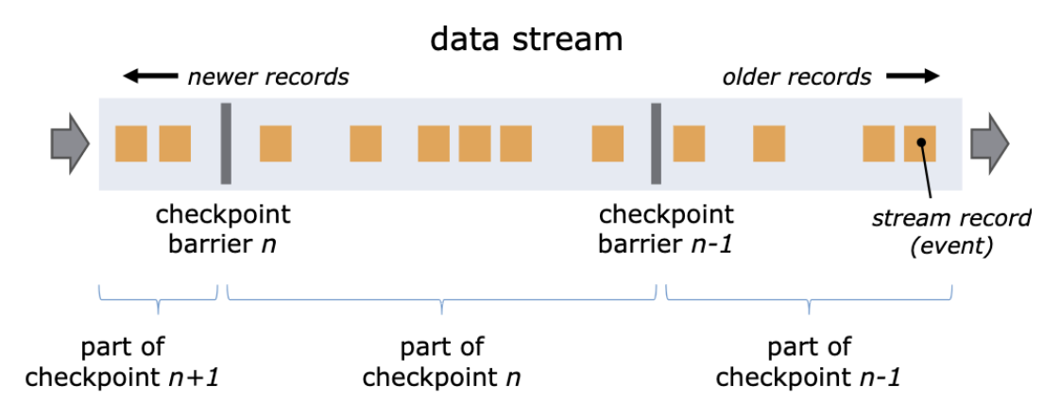
Checkpoint barrier for consistency

Slide 94
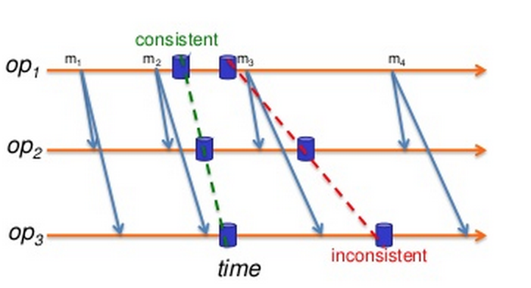
(Review)When to save checkpoints in MPI
Checkpoints can not be saved at any points.
Coordination is necessary
How frequent should we write checkpoint?
Too long? Too short?
Given a MTTF and the time for a checkpoint writing, what is the optimal checkpoint interval?

Slide 95
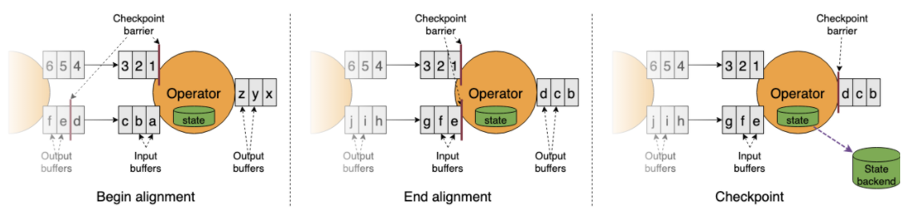
Aligned Checkpoints

Slide 96
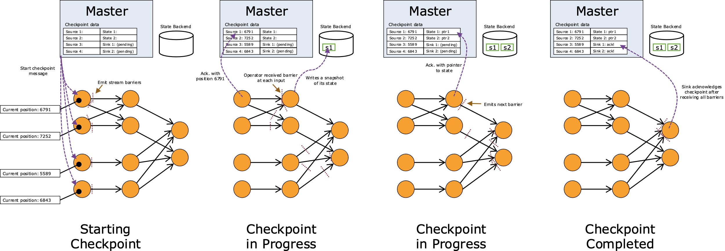

Slide 97
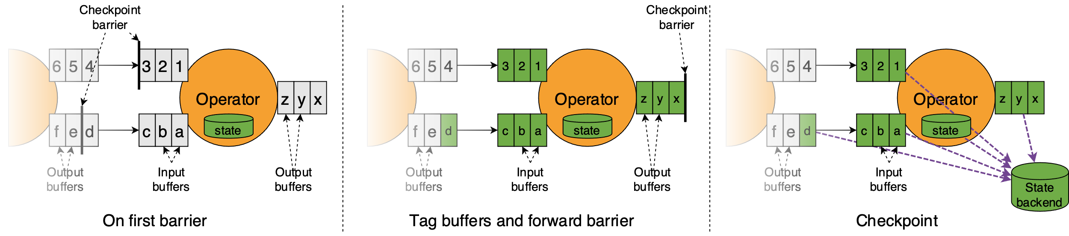
Unaligned Checkpoints

Slide 98
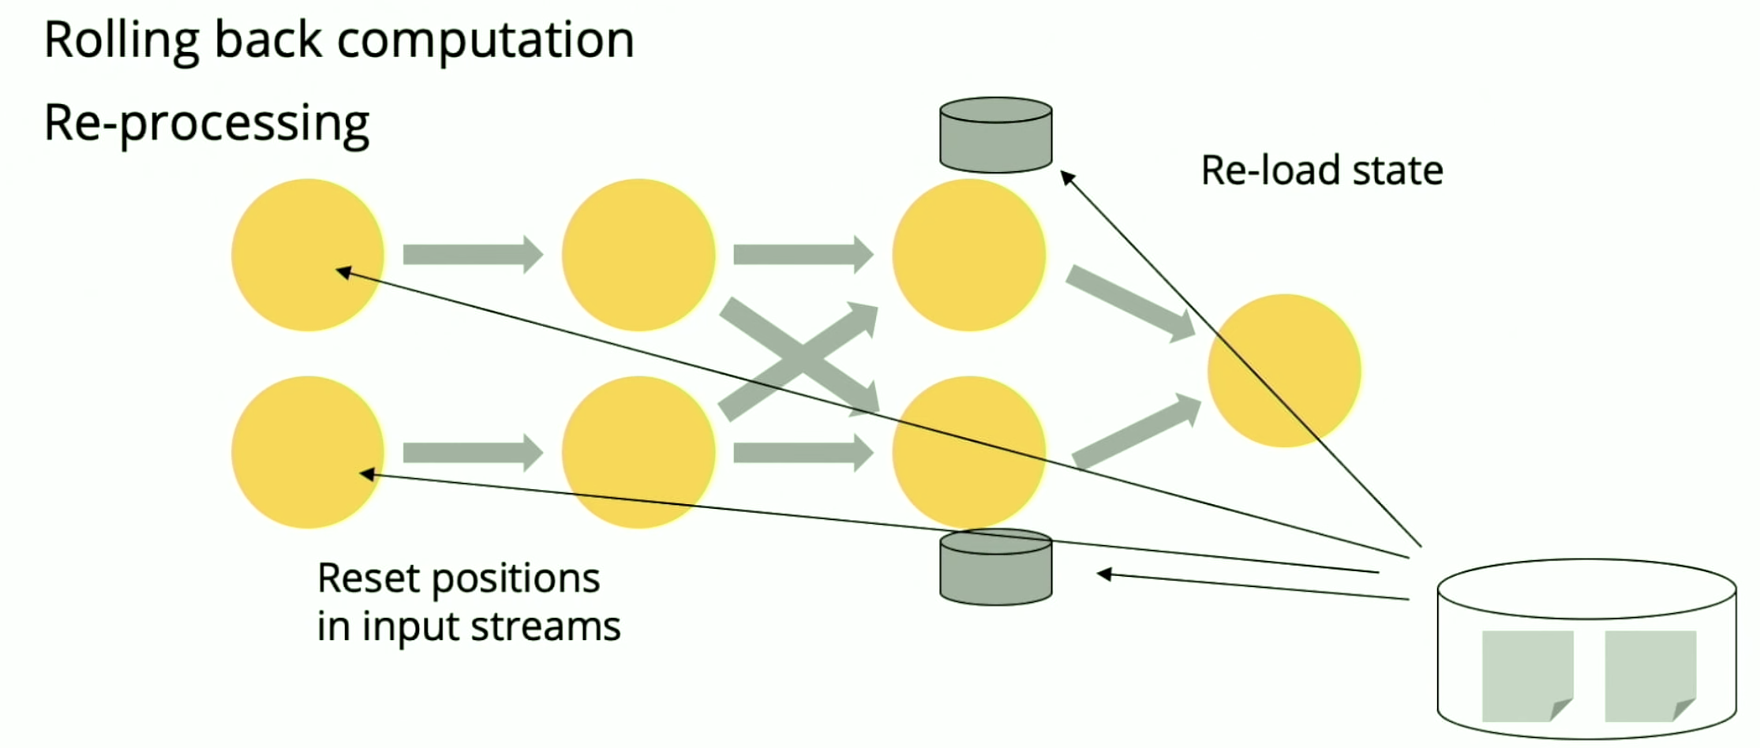
Fault tolerance for per-element processing
The queue as source will be able to buffer input for a while. But it is a problem that how fast the system can catch up, which translate to obsolete in data

Slide 99
Review the fault tolerance levels

Slide 100
Comparison of different systems

Slide 101
Comparison of different systems
Programming model
Storm and Flink requires save and processing more
SparkStream is an extension of Spark
But Flink provide SQL like interface which is very user friendly

Slide 102
Flow control
Push or pull
Spark uses push
Storm and Flink uses pull，buffer overflow only at the first stage
Pull is also known as back pressure

Slide 103
Fault tolerance
Fault Tolerance
Storm guarantees a message is processed (at least) once
SparkStream uses mini-batch to provide exact-once
Flink (and storm trident) can do per-message exactly once with checkpoint, with replayable source(kafka) and transactional sink

Slide 104
Community
Storm is a top level project of Apache,active community, used by twitter
Flink is a top level project of Apache, active community, used by Alibaba and many users
SparkStream is distributed with Spark

Slide 105
Benchmarking Streaming Processing Systems
http://www.redaktion.tu-berlin.de/fileadmin/fg131/Publikation/Papers/Stream_Benchmarks_ICDE18-CRC.pdf

Slide 106
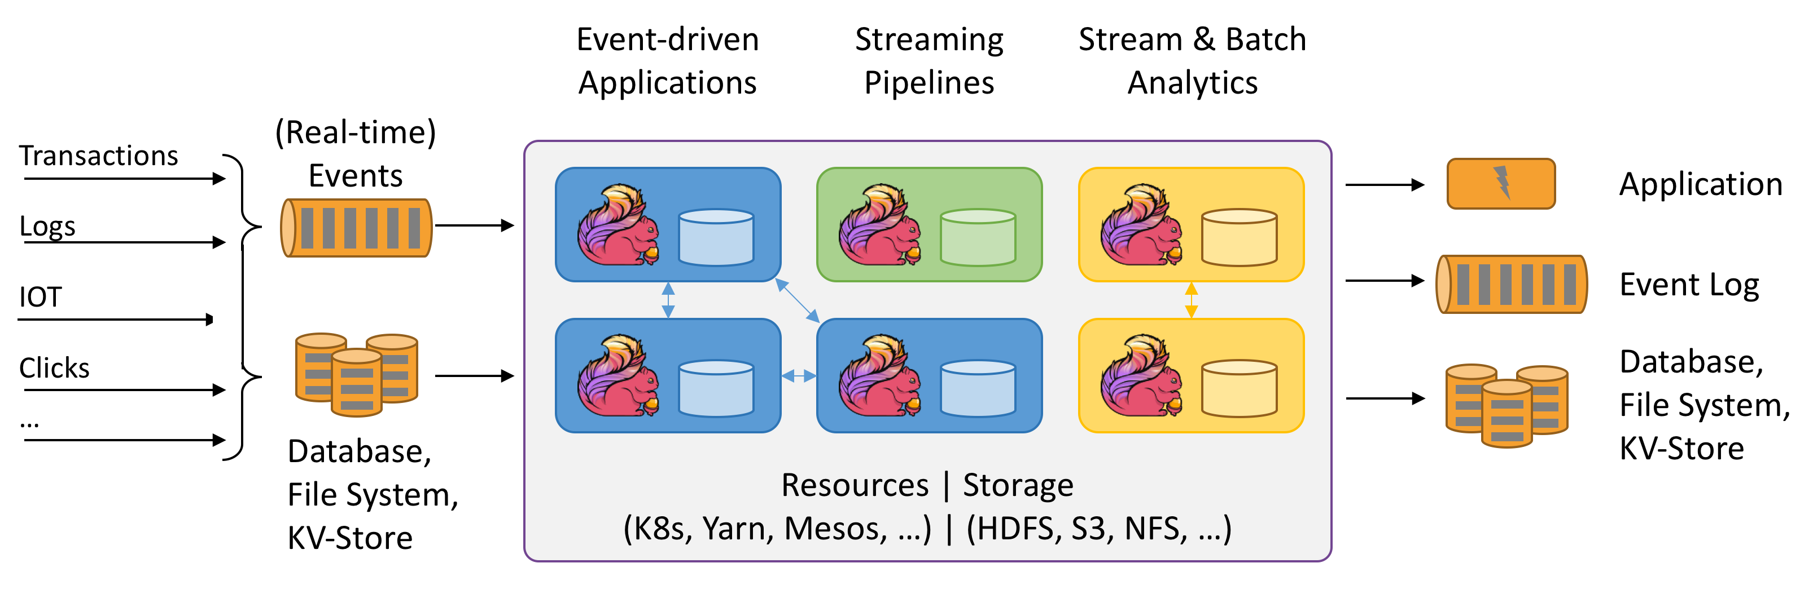
Summary
Streaming systems are widely used for low latency applications
Event log(queue) systems are critical for streaming systems
Actor models are often used to implement streaming systems
Fault tolerance is still the key objective for system design
Per-message and mini-batch to achieve different levels

Slide 107
Thanks

